Slide 1

GenZ Career Aspirations
Unveiling Insights Through Data: Career Preferences of GenZ

Slide 2
Introduction
GenZ is stepping into the workforce with unique aspirations, priorities, and expectations. Unlike previous generations, they emphasize flexibility, meaningful work, and personal growth. But what truly drives their career choices? This study aims to uncover key insights through data.
Why this study matters:
GenZ will make up 27% of the global workforce by 2025.
They challenge traditional career paths with gig economy jobs, remote work, and entrepreneurial ventures.
Companies need to align their hiring strategies with these evolving preferences.

Slide 3
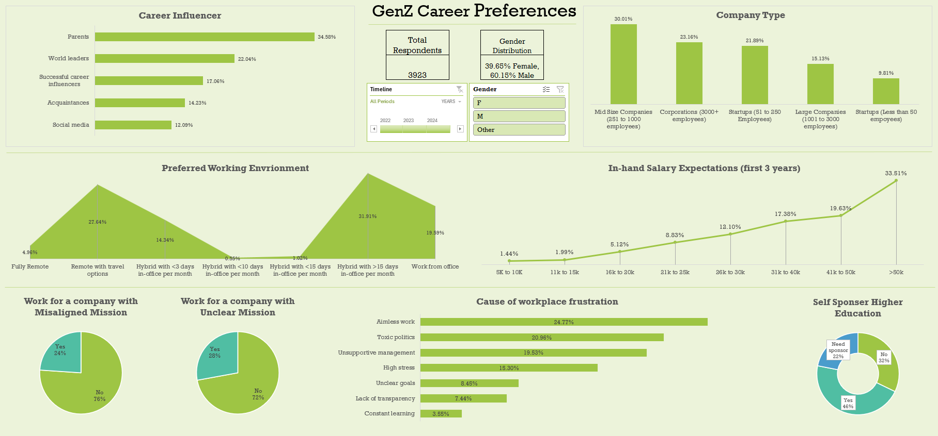
MS EXCEL DASHBOARD

Slide 4
What’s Inside?
Understanding the Problem (5W1H Framework)
Data Collection Approach
Data Cleaning & Preparation
Data Analysis & Key Trends
Key Takeaways & Recommendations
Power BI Dashboard

Slide 5
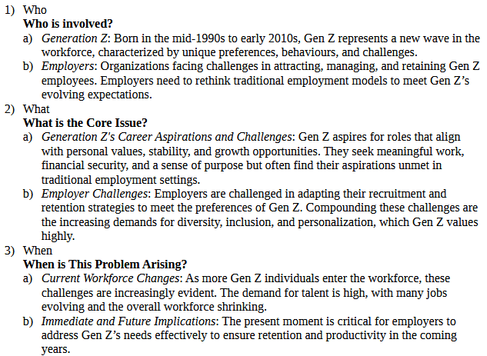
Understanding the problem statement

Slide 6
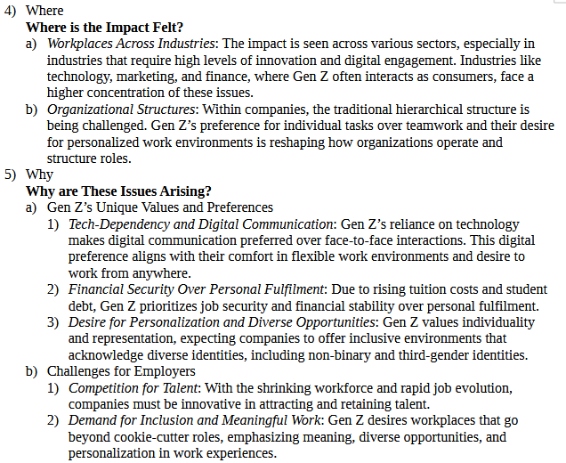
Understanding the problem statement

Slide 7
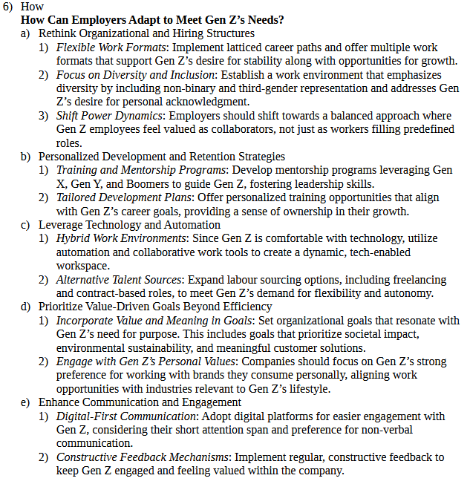
Understanding the problem statement

Slide 8
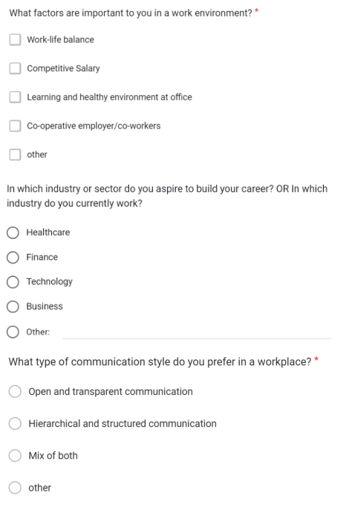
Data collection approach
Survey Design Highlights
Question Type : MCQ
Topics Covered:
Preferred industries & job roles
Salary expectations
Work-life balance preferences
Interest in remote/hybrid work
Career challenges
Key Considerations:
Ensuring clear, unbiased question phrasing
Encouraging anonymous responses for honest insights
Targeting diverse professional backgrounds

Slide 9

Data cleaning

Slide 10

Data Cleaning and standardization
Cleaning the Survey Data
Raw survey data often contains errors, inconsistencies, and missing values
Cleaning ensures accuracy, reliability, and usability for analysis
Tools Used: Microsoft Excel (Power Query, Formulas)
Steps in Data Cleaning:
Handling Inconsistencies
Managing Missing Values
Removing Duplicate Responses

Slide 11


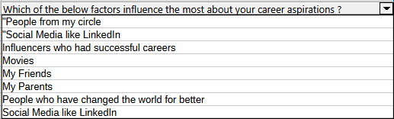
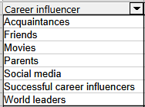
From Raw to Refined

Slide 12

Data analysis

Slide 13
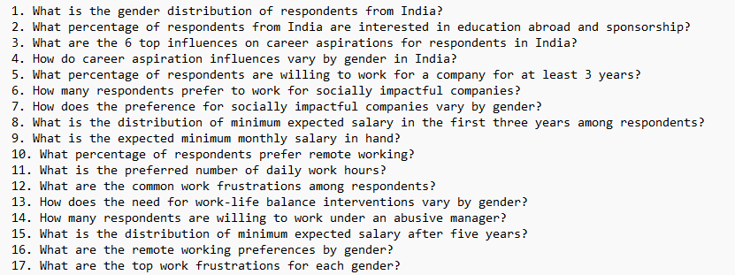
business questions
Turning Data into Insights: Excel & SQL Analysis

Slide 14
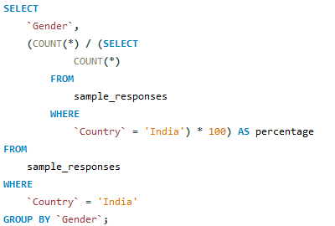
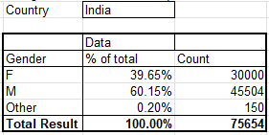
Gender distribution
39.65% of total respondents were female whereas 60.15% of total respondents were male

Slide 15
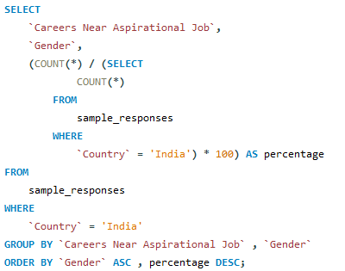
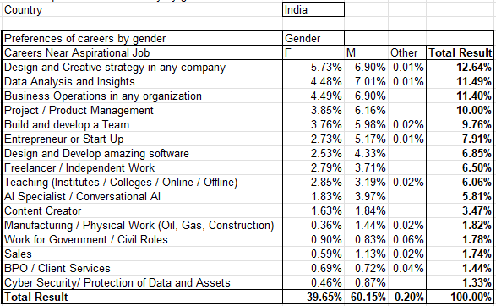
Career near aspirational job
Most aspirational job for females is design and creative strategy and for males is data analytics

Slide 16
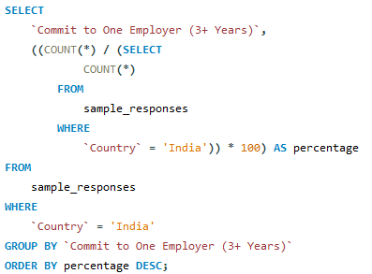
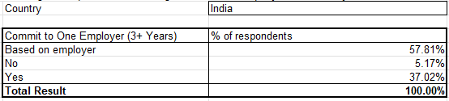
Commit for 3+ years
About 58% of respondents choose commitment based on company's culture

Slide 17
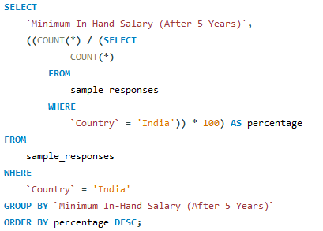
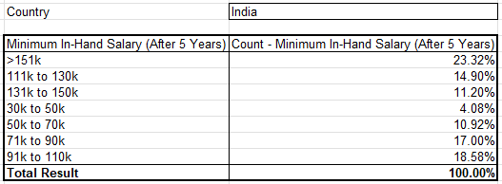
In-hand salary(5+ years)
Approx a one fourth of respondents expect >151k pay after 5 years

Slide 18

Power BI Dashboards

Slide 19
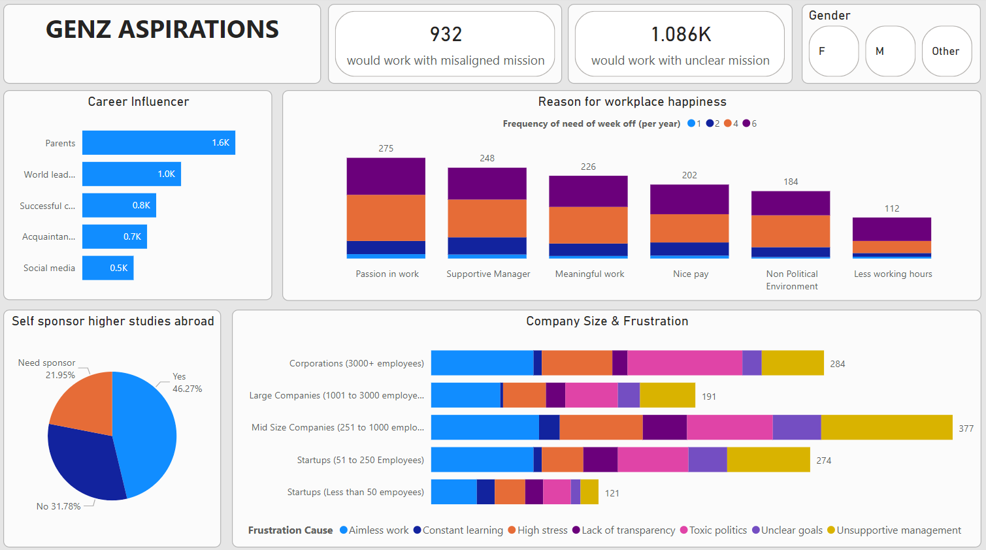

Slide 20
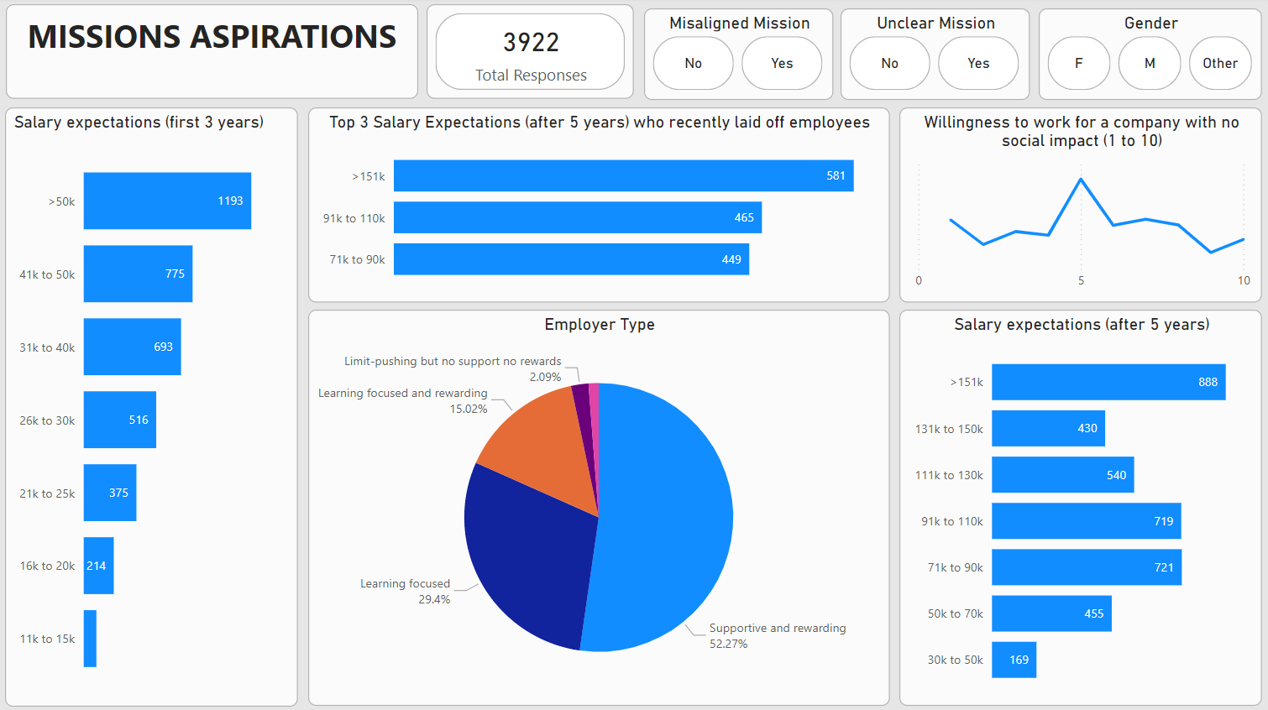

Slide 21
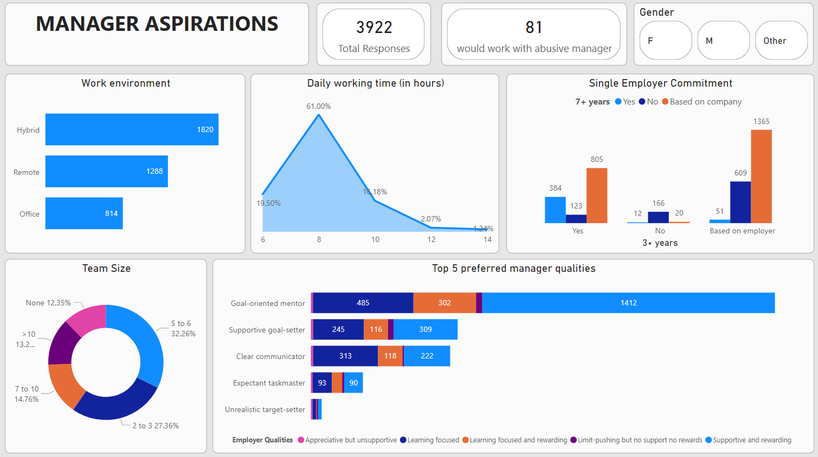

Slide 22

Insights and recommendations

Slide 23
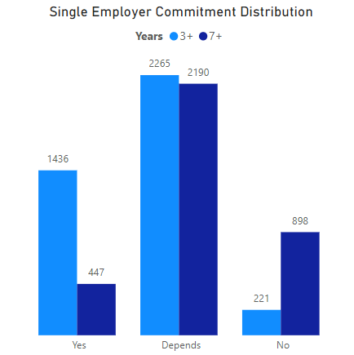
Single employer commitment
Key Insights
High Uncertainty: GenZ's commitment to a single employer is situational
Higher Decline in 7+ Years Commitment: Long-term loyalty is rare among GenZ
Recommendations
Enhance Career Growth Opportunities
Flexible Work Models & Benefits
Stronger Employer Branding

Slide 24
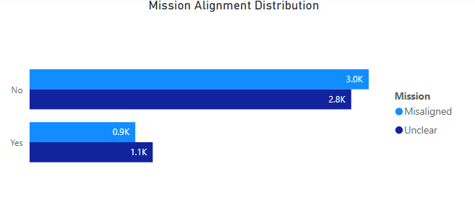
Mission alignment
Key Insights
High Misalignment & Uncertainty: A majority of GenZ employees struggle to connect with their company’s mission
Unclear Understanding is a Major Factor
Recommendations
Improve Communication
Align Personal & Company Values
Incorporate Employee Voice

Slide 25
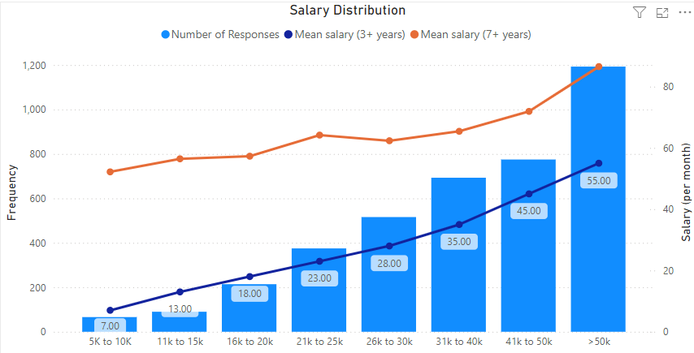
Salary distibution
Key Insights
The mean salary expectation for 7+ years is consistently higher than 3+ years, indicating GenZ anticipates steady salary growth over time
Majority Expect Moderate Salaries (21K-50K)
Recommendations
Transparent Career Growth Plans
Competitive Compensation Strategy
Skill-Based Salary Growth

Slide 26
Future scope
For Employers:
Offer career growth opportunities to retain GenZ talent.
Enhance mission communication & engagement strategies.
Adopt flexible work models & competitive compensation.
For Researchers & Analysts:
Future studies could explore industry-specific GenZ expectations.
Conduct deeper AI-driven sentiment analysis to predict long-term workforce trends

Slide 27

Thank you
"This study highlights how GenZ is reshaping the workforce with evolving career expectations. Businesses must adapt to retain and engage the next generation of professionals."

